Slide 1


MECHANISATION OF HYDROPONIC CULTIVATION
Presented in partial fulfillment for the award of the degree of
Bachelor of technology
in
Mechanical Engineering
Under the guidance of
Dr. J.P. Yadav
Prof. and H.O.D.
Mechanical Engineering Department
Baba Sahab Dr. B.R. Ambedkar College of Agricultural Engineering and Technology, Etawah-206001
(C.S.A. University of Agriculture & Technology, Kanpur)
Session- 2017-18

Slide 2

Submitted By:
Damini Singh Gaur CT-2343/14
Rahul Raj Dravid CT-2345/14
Swaranjali Maurya CT-2346/14
Mukul Kr. Gangwar CT-2352/14
Ashish CT-2359/14
Shivam Gautam CT-2361/14

Slide 3
CONTENT
Introduction
Objective
Methods and materials
Component Drip and Ebb & Flow Hydroponic System
Polyshed structure and growing bed
Environmental control
Environment inside greenhouse
Experiment on hydroponic green fodder
Conclusion
Future Scope

Slide 4
INTRODUCTION
The word hydroponics is made of three words:
Hydro(water) + Ponos (labour or working)
+ ics (Principles)
Hydroponics is a high-tech method of growing plants in water rich in mineral nutrients instead of soil.
WHY HYDROPONICS? : Growing food without dirt, earthworms, and sometimes sunshine may go against common ideas of where healthy food comes from. But hydroponics has taken off for good reason. It offers a number of benefits over traditional soil methods and it may even help to solve some of the world’s growing problems.

Slide 5
OBJECTIVE
The aim of this project is to install hydroponic culture setup for growing the plants without using soil media, in which climatic state can be controlled by using psychrometric analysis and mechanical equipments.

Slide 6
Methods and materials

Slide 7
Methods
1. WICK SYSTEM
2. DEEP WATER CULTURE
4. EBB AND FLOW
6. DRIP SYSTEM
5. AEROPONICS
3. NUTRIENT FILM TECHNIQUE

Slide 8
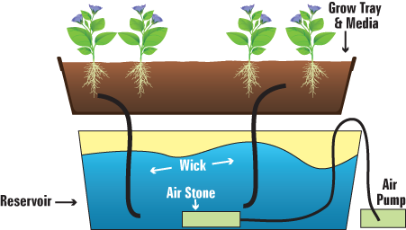
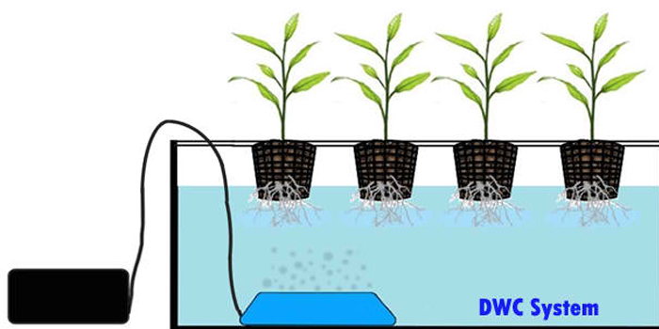
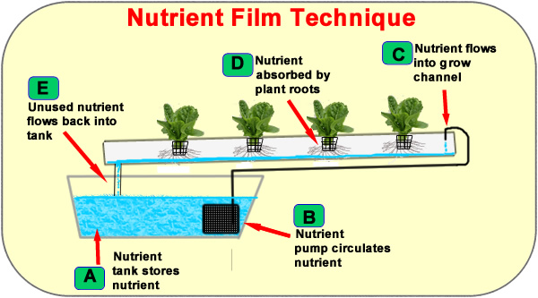
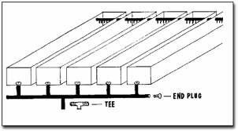
FIG 1: Wick System
FIG 2: Deep Water System
FIG 3: Nutrient Film Technique
FIG 4: EBB And Flow

Slide 9
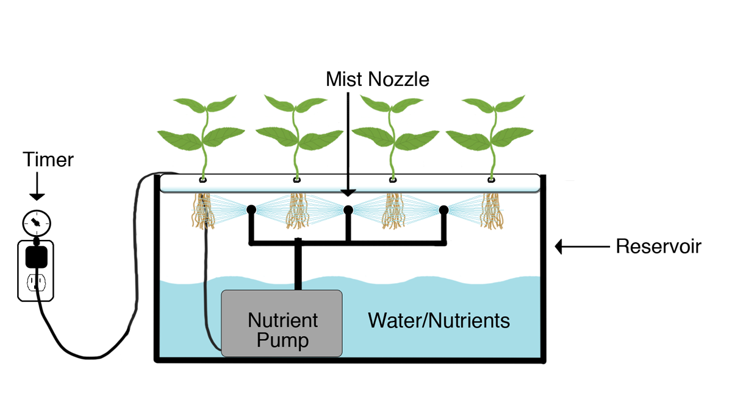
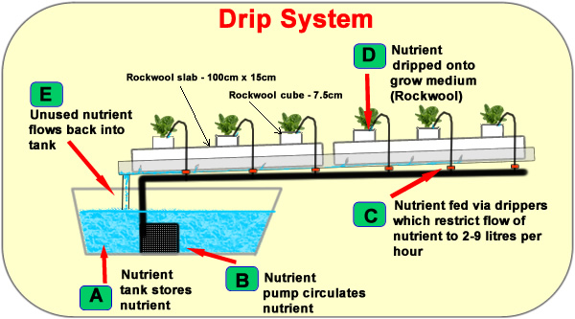
FIG 5: Aeroponics
FIG 6: Drip System

Slide 10
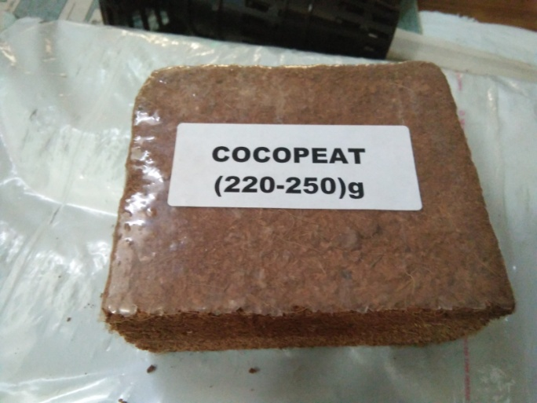
Materials
1. Coco Coir:
Has an excellent air to water ratio with great water retention
2. Rockwool:
A fibrous material made from melted rock.
Excellent water retention
3. Expanded Clay pellets:
Most popular media
50/50 mix of clay and coco create breathable medium.
Use in Ebb and Flow, water culture

Slide 11
Component used for Drip and Ebb & Flow Hydroponic System
Self adjusting shed structure
Mist and cooling system
Nozzle with water pump/ fogger for winter use
Poly paper
Hygrometer
LED lamp & UV bulb – hps (high pr. Sodium bulb), metal highlight
pH meter
TDS meter
Timer programmable controller
Seedling trays
Holey trays
Jute bags
Water pipes
Seeds (wheat, maize, barley)

Slide 12
1.Self adjusting model shed:
In this model shed, it is a low cost and air drag resisting bamboo shed.
All the members of this model are rigid because it has zero degree of freedom which made it a structure and it is very beneficial in every condition at all over places.
2.Mist and cooling system: The process of misting or fogging is used in a variety of applications to control humidity and temperature, improve air quality, and even provide visual effects. High pressure misting is accomplished by spraying water through nozzles with tiny orifices which are specially selected for each type of application.

Slide 13
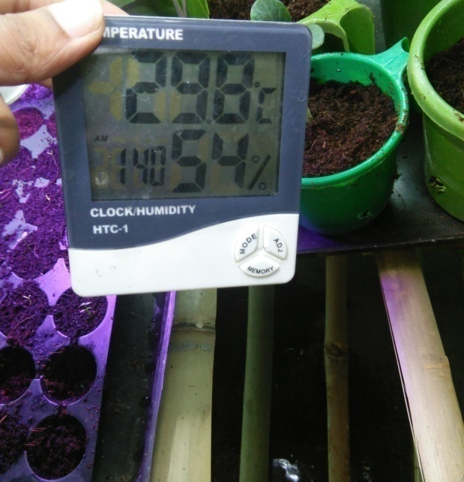
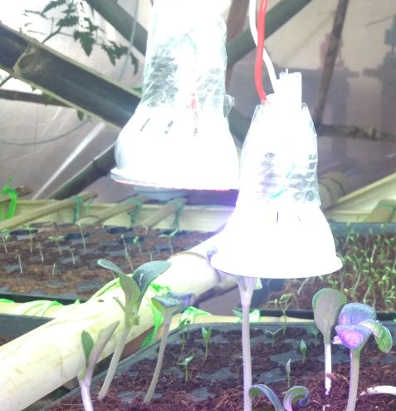
4. Nozzle with water pump: Nozzle produce fine particle of water which provide desirable humidity in greenhouse and also mist for plant. The water pump provide pressure and force to water in the nozzle.
In greenhouse we can easily maintain temperature with in the range 24ºC to 30ºC, which is good for leafy plants
5. Hygrometer: Relative humidity of atmosphere is measured by hygrometer in percentage.
6. LED bulb and UV bulb: LED bulb are artificial source of sun light . UV disinfection will kill waterborne pathogens in recirculating hydroponics systems.
Digital Hygrometer
Grower Light

Slide 14
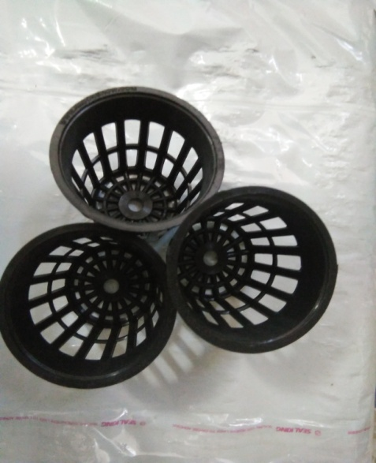
7.pH meter: pH meter is used for measuring the water nutrient solution of plants.
8.TDS meter: TDS meter is used for measuring the impurities of water in terms of parts per millions.
9.Timer programmable controller:Timer programmable
controller is used for many processes which are based upon
timed events. Example-mist system.
10. Seedling tray: Seedling tray is filled with soil or compost and is used for planting seeds. It is also called as cell tray or cavity tray.
11.Holey tray: Holey tray are used for germination of seed before planting it in seedling tray.
12.Joot bags: This is used to cover the seedling tray to keeping darkness, maintain humidity & preventing seeds from direct sunlight.
13.Water pipes: Water pipes are used to connect the nozzles to the water pump.
14.Seeds: Wheat, maize, barley, etc.
Holey Trays
Net cups

Slide 15
Polyshed structure and growing bed

Slide 16
Bamboo
Bamboo is a wood-like plant that is a part of the grass family, consisting of a
cylindrical hollow shoot, or culm. This culm is covered with a waxy surface,
which prevents moisture from escaping. At intervals, the culm has raised
ridges called nodes, from which branches will offshoot.
Properties of Bamboo:
1.Tensile Strength
2.Compressive Strength
3.Elastic modulus
4.Anisotropic properties
5.Shrinkage
6.Fire resistance

Slide 17
Advantages and disadvantages of bamboo
1. Advantages of Bamboo
Light , strong & versatile.
Environment friendly (Production of 1 ton of steel emits more than 2 ton of CO₂ in the atmosphere while production of 1 ton of bamboo consumes more than1 ton of CO₂ of the atmosphere.)
Self renewing resource.
Fast growing.
Highly productive.
2.Disadvantages of Bamboo
Require preservation.
Shaped by nature.
Lack of design guidance & codes.
Untreated bamboo is harmed by the fungi , insects .
Structural efficiency is low.

Slide 18
Working of Bamboo: Splitting
The cane is split in halves & quarter.
The cane is cut with a knife into four or eight segments.
Cane is used in the form of stripes and battens.
Preservation of bamboo
For the preservation of Bamboo from insects & microorganism . We used to treat it with borax & boric acid using modified baucherie method which increase its life up to 40 – 50 years.

Slide 19
Modified Baucherie Method
The basic Boucherie method has been improved by the introduction of pneumatic pressure over the preservative fluid in a reservoir, for example by using an air pump or electric pump.
In the Boucherie method, the sap is displaced by preservative chemicals by gravity. The culm is connected to a container of preservative solution kept at a higher level.
In the modified Boucherie method, pressure is applied in the range of 100-140 kPa.
In this way the time of treatment can be reduced from several days to 3-8 hours.

Slide 20
Components used in Modified Baucherie Method
Chemical reservoir : A high pressure cylinder reservoir which can wear upto 70 psi. It has three valve. These are-
1.Inlet valve 2.Air pressure valve 3.Outlet valve
Rubber hose: A high pressure rubber tube which can bear up to 120psi.
Iron hose : The R-socket type hose which is used to regulate the supply of chemicals in bamboo.
Coupling: A high strength elastopolymer which can bear pressure up to 70psi.
Pressure pump: It is paddle operated air pressure pump which can fill the air in reservoir at required pressure up to 100psi.

Slide 21
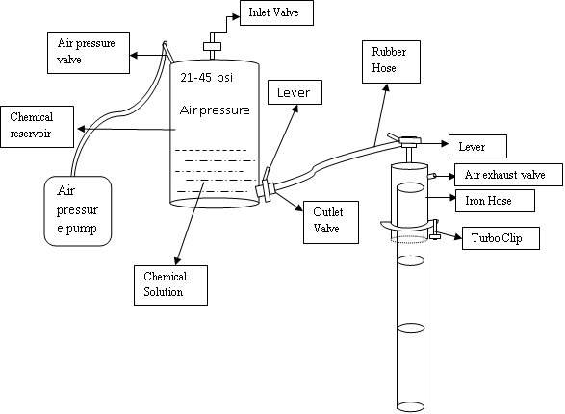
Schematic diagram of modified baucherie method

Slide 22
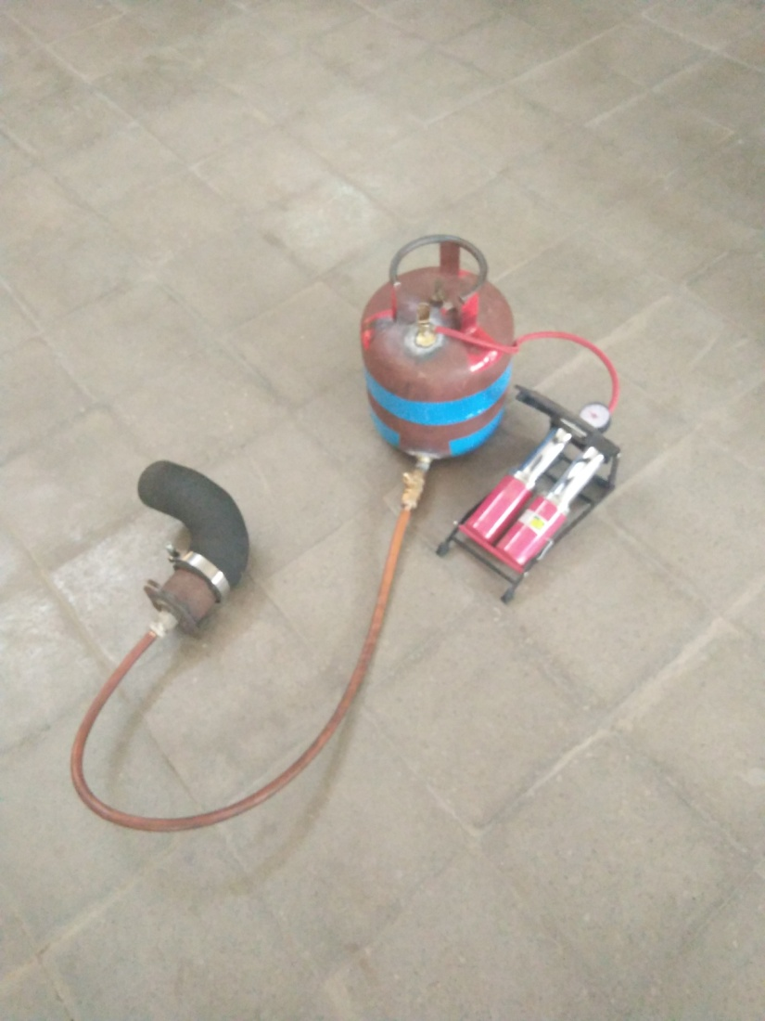
Setup of Modified Baucherie Method

Slide 23
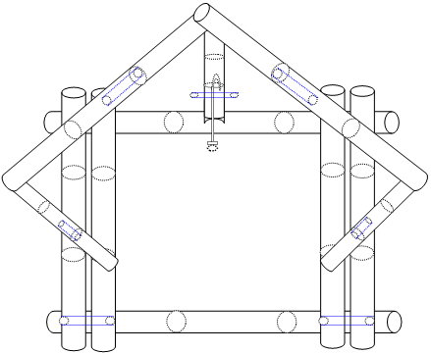
Polyshed bamboo structure

Slide 24
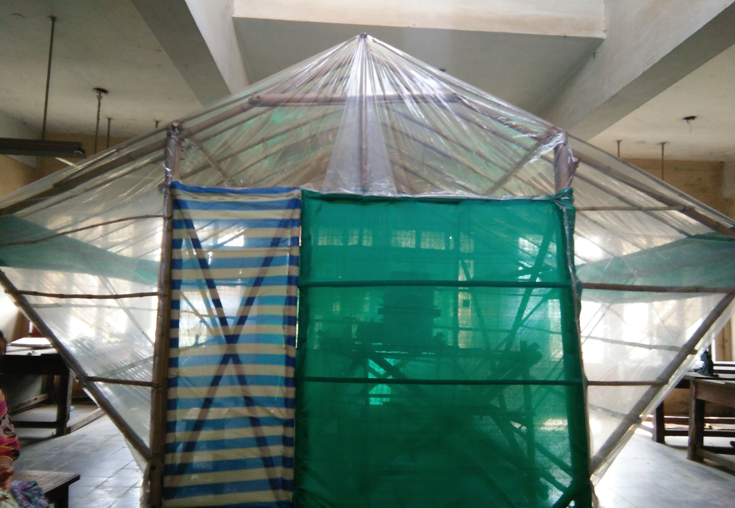
Greenhouse

Slide 25
GROWING BED
The growing bed made of treated bamboos. The platform of bed should be 1.5 feet apart to each other by this way the grown fodder grow up to full length and proper sunlight.
Within 8 to 10 days the fodder reaches up to 1 feet above and the remaining 0.5 feet used for proper ventilation. The ventilation prevent to plants for suffocation and good ventilation, have good air flow which provide proper amount of CO₂ and O_{2..}Also proper ventilation prevent harmful mould attack on fodder.
The platform should be inclined 5⁰ to 6⁰ which provide proper water flow when fodder growing.
Due to proper height, the misting water reaches to every place in the tray.

Slide 26
8 feet
1.5 feet
4.5
1.5 feet
1.5 feet
4 feet
Structure of growing bed

Slide 27
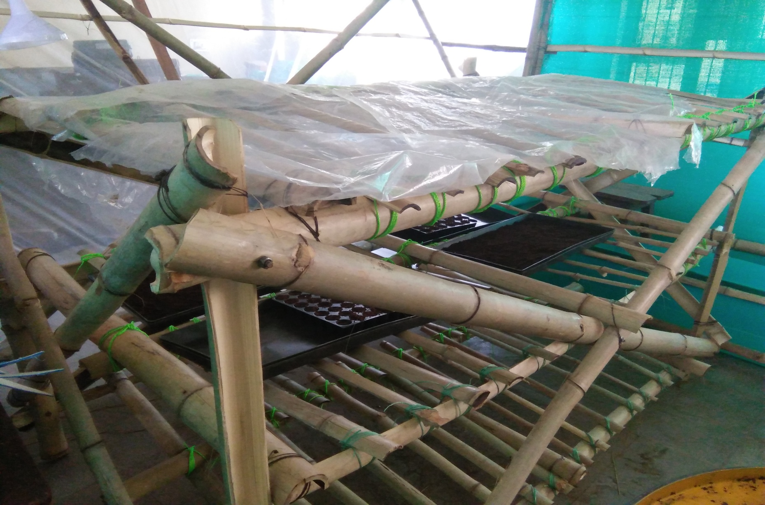
Growing Bed

Slide 28
Environmental control

Slide 29
Mist cooling system
The process of misting is used to control humidity & temperature , improve air quality & even provide visual effects.
Components used in mist cooling system
1.Nozzle
A device that increases the velocity of fluid at the expenses of pressure.
2.Throttle valve
A mechanical device that restricting flow which causes a significant pressure drop in the fluid.
3.Foot valve: Foot valve filter screen which filters sediments & device into the water tank.

Slide 30
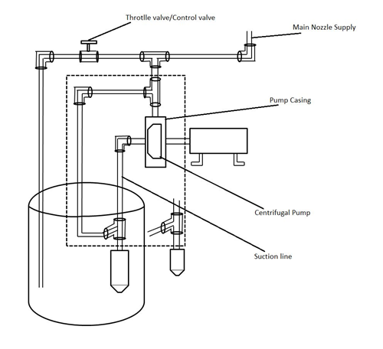
Working of mist cooling system

Slide 31


Slide 32
Environment
inside greenhouse

Slide 33
Greenhouse vs polyhouse
Polyhouse is a type of greenhouse made of polythene. The general consideration is a polyhouse is a confined structure without crop and plant while greenhouse is a covered structure having crop/plants.
Conservation of mass in greenhouse and mass balance equation
m_{in} - m_{out} + m_{gen} - m_{con} = dm/dt
C
B
D
E
m_{gen}
A
m_{in}
m_{out}
m_{con}
G
F

Slide 34
Energy transfer mechanism - Advection
Receiving heat and bulk motion of vaporized water molecules via advection is takes place inside the polyhouse.
T_{in}
T_{out}
q_{advection}

Slide 35
Mass transport mechanism- Advection
C_{in}
C_{out}
m_{advection}

Slide 36
High tech “Semi closed” Greenhouse
Air treatment
Humidification
Cooling
Dehumidification
Heating
Natural ventilation
Forced ventilation
Cooler +fan
Outside air
Air treatment unit
Air
inlet
Air outlet

Slide 37
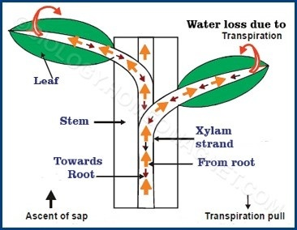
How Plants xylem works
Xylem moves the water and liquid nutrient from the root to leaves.

Slide 38
Experiment on hydroponic green fodder

Slide 39
Hydroponic Green Fodder
Green fodder is one of the important input and plays major role in feed of milch animals. Green fodder provides required nutrients/mineral for milk production and health of the dairy animals or livestock. Control of feed cost in dairy animals impacts the profits and result in successful dairy farming.
We experimented on hydroponic green fodder are as follows:-
Wheat
Maize
Barley

Slide 40
Need of Hydroponic technology in green fodder production
Hydroponic technology is required to overcome the following constraints for the production of quality green fodder in India especially in dairy farmers.
In case of small land holdings.
In case of non-availability of fertile lands for green fodder cultivation.
When the irrigation/water facility, fencing, land preparations resources /labour are limited.
In mining and coastal belt areas where it has limited area for growing green fodder dairy industry.
In areas, where destruction of fodder is caused by stray cattle’s and other wild animals.
In regions, where dairy farmers spend higher cost for labour for green fodder cultivation.
In areas, where poor participation of educated unemployed youths for green fodder production.
In regions, where demand of green fodder is very high against existing availability of the fodder.

Slide 41
Hydroponic Fodder – Steps involved:
Firstly, we select quality seed/grains for hydroponic green fodder. We can select maize, wheat and barley. Take 1 kg of grain / seed and divide it in 2 parts. Half kg of seed in each tray and clean the grains from dead seeds or broken seeds. Grains should be washed with the solution of sodium hypochlorite and leave the grains for half hour (30 minutes) in the solution. After draining the grains, soak them in fresh water for whole day (24 hours).
Soaked seeds should be drained properly and left them for 5 hours in open air before placing in the tray and keep the tray in the rack for 2 days (48 hours) to allow the germination process.
After seed germination, frequent water sprinkling is required for growth of the fodder and proper sunlight/temperature should be maintained. We can leave the sprouted seeds in the tray for 5 to 6 days and provide regular and frequent water sprinkling. Once the fodder reaches certain height, we can take it directly from the tray and feed the entire plant to milch animal. Don’t forget to take the fodder with roots.

Slide 42
Psychrometric analysis
A psychrometry gives knowledge about physical and thermal properties of moist air in a graphical form. It can be very helpful in troubleshooting greenhouse or livestock building environmental problems and in determining solutions.
To control the humidity and temperature, it is very necessary for proper plant growth.
High humidity will actually suffocate the plants so relative humidity level should be monitor and control.
Plants are also very sensitive to temperature and must avoid extreme hot or cold at all costs.

Slide 43
We experiment on fodder wheat, barley and maize. Optimal range of temperature and humidity are shown in table given below.
Table: Fodder temperature and humidity
S.No. | Fodder | Temperature (Fahrenheit) | Humidity(%)
1. | Wheet | 65 – 80 | 40-80
2. | Barley | 65-80 | 40-80
3. | Maize | 75-90 | 50-70

Slide 44
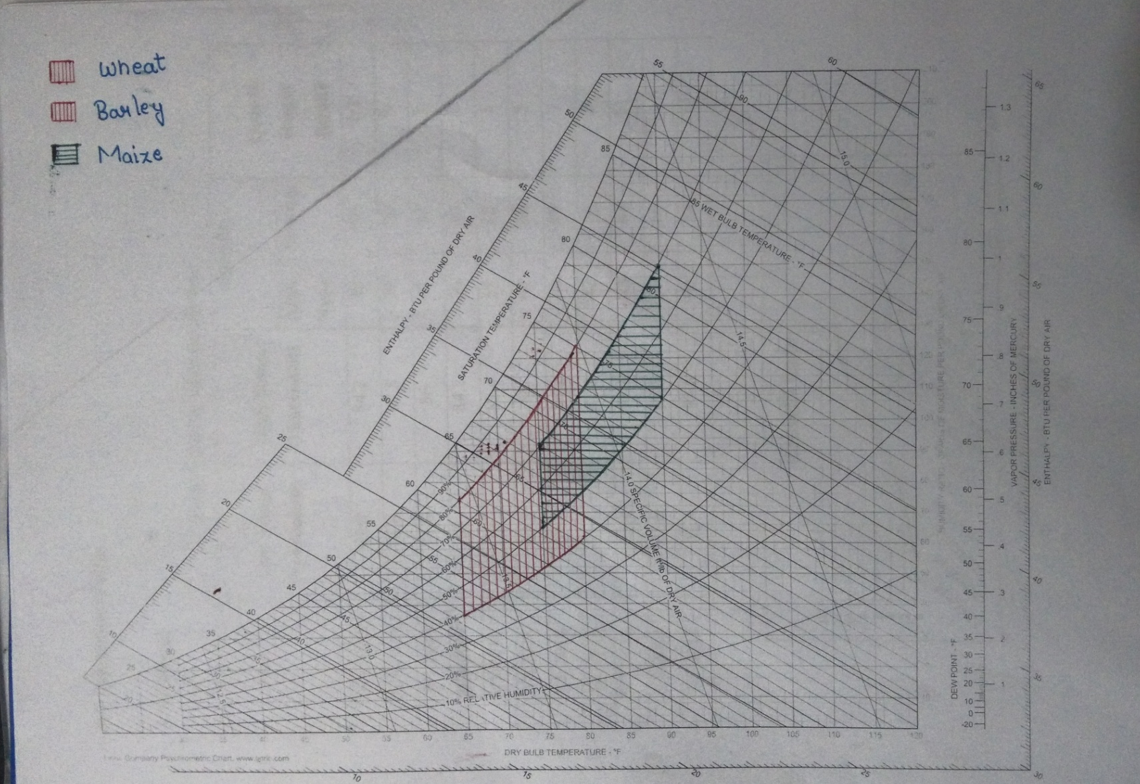
Pschrometry Chart

Slide 45
Table: Experimental data of wheat
Day | Low Temp. (Fahrenheit) | High Temp. (Fahrenheit) | Humidity |  | Growth Height (inch)
 |  |  | After Noon | Evening
27/4/2018 | 69.8 | 84.2 | 40 | 65 | 1/2
28/4/2018 | 71.6 | 87.8 | 39 | 90 | ½
29/4/2018 | 71.6 | 86 | 45 | 64 | 1
30/4/2018 | 68 | 84.2 | 36 | 46 | 2
1/5/2018 | 68 | 82.4 | 55 | 63 | 3
2/5/2018 | 69.8 | 86 | 60 | 68 | 5
3/5/2018 | 69.8 | 84.2 | 68 | 75 | 7
4/5/2018 | 71.6 | 87.8 | 42 | 56 | 9
5/5/2018 | 73.4 | 91.4 | 43 | 66 | 11
6/5/2018 | 71.6 | 87.8 | 55 | 66 | 11.5
7/5/2018 | 73.4 | 89.6 | 60 | 58 | 12

Slide 46
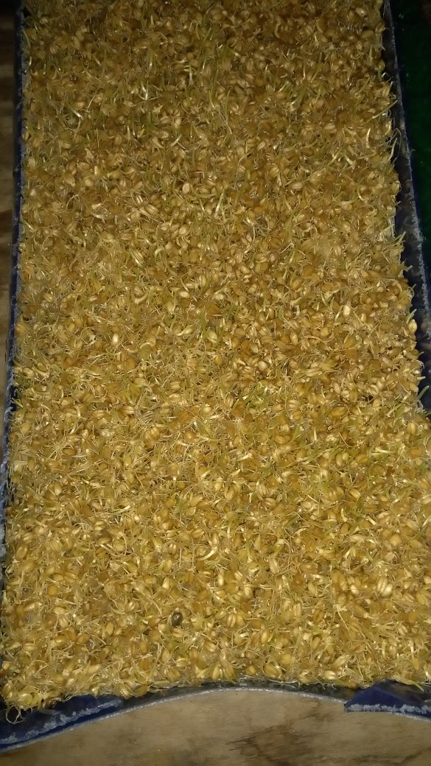
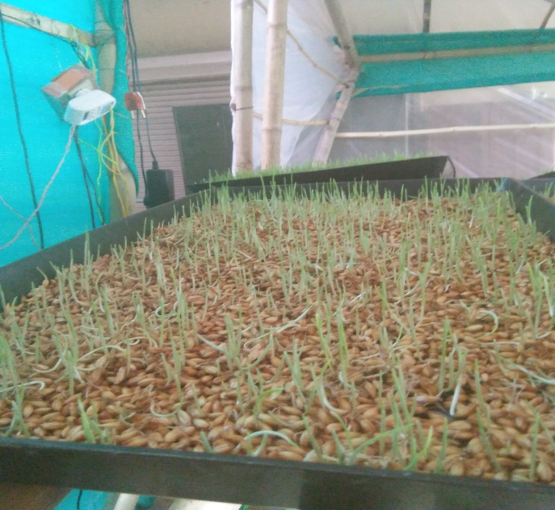
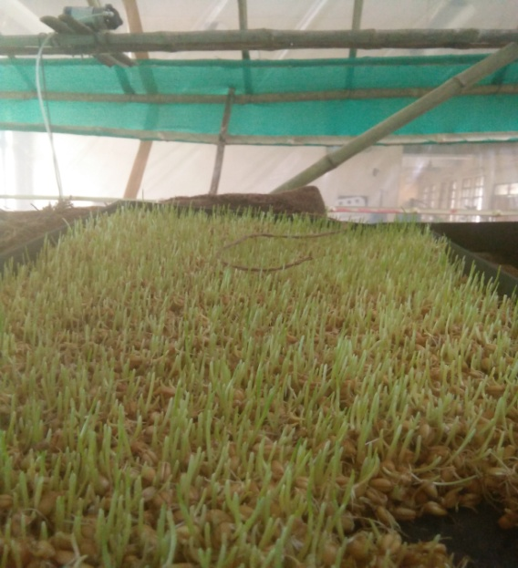
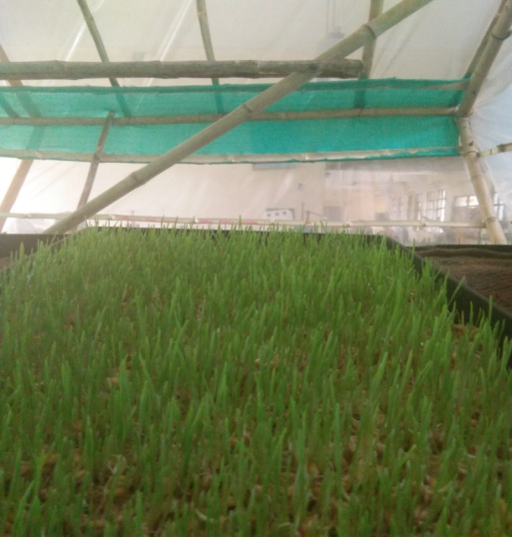
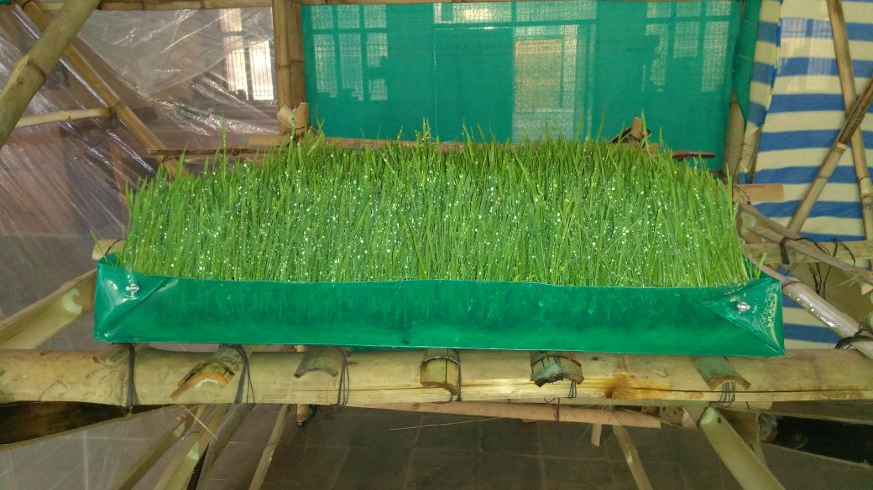
Wheat: After Soaking in Jute
(Germination starts) Day 1
Day 2 and 3
Day 3 and 4
Day 5 and 6
Day 7 and 8

Slide 47
inch
day
Graph of growth rate of wheat day vs height(inch)

Slide 48
Table: Experimental data of Maize
Day | Low Temp. (Fahrenheit) | High Temp. (Fahrenheit) | Humidity |  | Growth Height (inch)
 |  |  | After Noon | Evening
10/5/2018 | 69.8 | 89.6 | 39 | 55 | ½
11/5/2018 | 71.6 | 91.4 | 35 | 58 | 1
12/5/2018 | 75.2 | 86 | 32 | 66 | ½
13/5/2018 | 73.4 | 89.6 | 37 | 51 | 2
14/5/2018 | 68 | 86 | 41 | 62 | 3
15/5/2018 | 71.6 | 89.6 | 45 | 44 | 4
16/5/2018 | 73.4 | 89.6 | 55 | 67 | 6
17/5/2018 | 77 | 93.2 | 38 | 58 | 7.5
18/5/2018 | 75.2 | 91.4 | 40 | 70 | 8.5
19/5/2018 | 73.4 | 95 | 48 | 71 | 10

Slide 49
inch
day
Graph of growth rate of maize day vs height(inch)

Slide 50
Table: Experimental data of Barley
Day | Low Temp. (Fahrenheit) | High Temp. (Fahrenheit) | Humidity |  | Growth Height (inch)
 |  |  | After Noon | Evening
27/4/2018 | 69.8 | 84.2 | 40 | 65 | ½
28/4/2018 | 71.6 | 87.8 | 39 | 90 | 1
29/4/2018 | 71.6 | 86 | 45 | 64 | 1.5
30/4/2018 | 68 | 84.2 | 36 | 46 | 2
1/5/2018 | 68 | 82.4 | 55 | 63 | 3
2/5/2018 | 69.8 | 86 | 60 | 68 | 4
3/5/2018 | 69.8 | 84.2 | 68 | 75 | 6
4/5/2018 | 71.6 | 87.8 | 42 | 56 | 7.5
5/5/2018 | 73.4 | 91.4 | 43 | 66 | 8
6/5/2018 | 71.6 | 87.8 | 55 | 66 | 9
7/5/2018 | 73.4 | 89.6 | 60 | 58 | 10

Slide 51
inch
day
Graph of growth rate of Barley day vs height(inch)

Slide 52
Comparison Table for Hydroponic Green Fodder Production vs. Conventional Green Fodder Production ( According to ICAR data)
S. No. | Attributes | Hydroponics green fodder | Conventional green fodder | Savings on
1 | Area | 1000 sq. meters | 50 sq. meter | Land
2 | Fodder production in days | 9-10 days | 65 to 70 days | Time period saving
3 | Water and electricity requirement | Very low | Very high | Water and electricity saving
4 | Soil fertility | Not essential | Very high | Saves the fertility requirement
5 | Fodder yield dependency | In controlled environment | On climate. Irrigation | No dependency on external factors
6 | Labour requirement | Very less | More | Saving on labour
7 | Green fodder utilization by animals | Complete/full | Partial | Reduction in green fodder waste

Slide 53
Conclusion
In the project Mechanization of Hydroponic Cultivation, meeting all the objectives, right from bamboo treating, fabrication, maintaining of environment friendly psychrometric parameter inside the greenhouse shed, the crop tested for its growth and compared with crops grown on conventional method and also validated with standard data(ICAR). The polyshed structure is hardly used and need to be patent. The economic analysis have also been done which shows that
As we need 2l/kg of water in hydroponic cultivation while 60-70 l/kg in conventional cultivation.
For 1 tonne fodder, we need 360 sq. feet area in hydroponic cultivation while 72000 sq. feet area in conventional cultivation.
Market price of hydroponic fodder is Rs 2000/tonne while market price of conventional cultivation is Rs. 6000-7000/tonne excluding transportation charge.

Slide 54
It has been concluded the crops
Fodder Wheat takes 9-10 days for proper growth up to 12 inch.
Fodder Maize also takes 9-10 days for proper growth up to 10 inch.
Fodder Barley also takes 9-10 days for proper growth up to 10 inch.
These above fodders takes approx 60-70days by using conventional method.
This hydroponic greenhouse shed could have been further improved for better and optimized result. There is no binding of time and money constraints.

Slide 55
Future Scope
Hydroponic technology can efficiently generate food crops from barren desert sand and desalinated ocean water, in mountainous regions too steep to farm, on city rooftops and concrete schoolyards and in arctic communities.
The various modification can be done in our project for future work which is given below:-
We can use all the methods of hydroponic instead of drip and Ebb & Flow system for the proper growth of plants.
We can reuse the drained water coming out from Ebb and flow system in drip system without treating it.
Sewage water can also be used after the proper treatment.

Slide 56
THANK YOU

